Slide 1
GOVERNMENT ENGINEERING COLLEGE HASSAN
PRESENTATION ON
“Light Weight Authentication of Devices in Wireless Sensor Network”
Under the guidance of,
Prof. Shylaja N S , B.E., MTech.
Head of the Department
Dept. of CSE
Submitted By,
INDU A - 4GH22CS401

Slide 2
CONTENTS
1. INTRODUCTION
2. OBJECTIVES
3. METHODOLOGY
4. APPLICATIONS
5. ADVANTAGES AND DISADVANTAGES
6. CONCLUSION
7. REFERENCE

Slide 3
INTRODUCTION
Wireless Sensor Networks consist of a large number of small, resource-constrained devices deployed to monitor and collect data from various environments.
These devices often operate in remote or unattended locations, making them vulnerable to a variety of security threats.
Due to advancements in communication technologies, WSNs are increasingly used in applications such as environmental monitoring, healthcare, military surveillance, industrial automation, and smart cities.

Slide 4
INTRODUCTION
To ensure secure communication, it is essential to authenticate devices within the network without exhausting their limited resources.
Lightweight authentication protocols are designed to provide security features like identity verification, confidentiality, and integrity while maintaining low computational overhead.
These protocols play a vital role in enabling secure and efficient data exchange across geographically distributed sensor nodes.

Slide 5
OBJECTIVES
The objectives of Task Scheduling in Cloud Computing: A Priority-Based Heuristic Approach.
Investigating the impact of task prioritization on overall system performance.
Developing algorithms to efficiently assign priorities to tasks based on their characteristics.
Evaluating the effectiveness of the proposed heuristic approach in real-world cloud computing scenarios.

Slide 6
METHODOLOGY
The image have provided appears to be a flowchart that outlines a task scheduling and execution process in a data center environment. The flow begins with users submitting tasks to a scheduler, which employs a Priority Assignment Technique (PAT) to prioritize the tasks. These tasks are then assigned to Virtual Machines (VMs) using a Fibonacci Heap data structure, optimizing the allocation process for efficient execution.

Slide 7
METHODOLOGY
Once assigned, the tasks are executed within the data center, where multiple VMs work collaboratively to manage the task execution. A First In First Out (FIFO) queue is used to manage and order tasks during this phase. The flowchart visually represents the journey of tasks from user submission through prioritization, assignment, and execution, highlighting the importance of efficient scheduling in data center operations. The use of PAT and Fibonacci Heap suggests a focus on performance optimization.

Slide 8
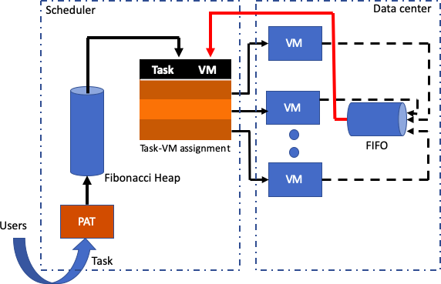

Slide 9
APPLICATIONS
Resource Management: Efficient allocation of tasks to available resources in cloud environments.
Performance Optimization: Minimization of task completion times and enhancement of overall system performance.
Cost Efficiency: Reduction of operational costs by optimizing resource utilization.
Quality of Service (QoS) Enhancement: Improvement of user satisfaction through better to service-level agreements.
Dynamic Workload Management: Adaptation to changing workload conditions for maintaining efficiency.

Slide 10
ADVANTAGES
Resource Optimization: Maximizes resource utilization by prioritizing critical tasks.
Performance Enhancement: Improves system performance by reducing task completion times and enhancing response times.
Dynamic Adaptation: Adjusts scheduling dynamically to changing workload conditions, maintaining efficiency.
Cost Savings: Minimizes resource provisioning costs by optimizing resource usage.
Scalability: Scales effectively to handle large cloud environments with numerous tasks.

Slide 11
DISADVANTAGES
Increased Complexity: Adds complexity to system management and maintenance.
Computational Overhead: Introduces computational overhead for calculating task priorities.
Suboptimal Solutions: May not always produce optimal task scheduling outcomes.
Dependency on Design: Effectiveness relies heavily on the design and implementation of heuristics.
Parameter Tuning Difficulty: Fine-tuning heuristic parameters can be challenging and time-consuming.

Slide 12
CONCLUTION
In conclusion, the future of task scheduling in cloud computing holds tremendous potential for innovation and improvement. By exploring adaptive scheduling algorithms, harnessing the power of machine learning, delving into quantum computing, and tailoring scheduling approaches to specific application domains, researchers can continue to push the boundaries of efficiency and scalability in cloud computing environments. These advancements not only hold the promise of enhancing system performance and resource utilization but also contribute to shaping the future landscape of cloud computing as a whole.

Slide 13
REFERENCE
[1] D. C. Marinescu, Cloud computing: theory and practice, Morgan Kaufmann, 2017.
[2] Distributed and Cloud Computing, From Parallel Processing to the Internet of Things”, Morgan Kaufmann Publishers, 2012.
[3] T. A. Genez, L. F. Bittencourt and E. R. Madeira, "Workflow scheduling for SaaS/PaaS cloud providers considering two SLA levels", IEEE Network Operations and Management Symposium, pp. 906-912, 2012.

Slide 14
THANK YOU!!

